Slide 1
Microsoft PowerPoint
From Wikipedia, the free encyclopedia
Notes:
Add your speaker notes are here.

Slide 2
Overview
PowerPoint is a presentation program
Created by Robert Gaskins and Dennis Austin
Released on April 20th, 1987
Forethought, Inc
Acquired by Microsoft for $14 million
Microsoft’s first significant acquisition

Slide 3
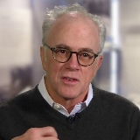
Original Inventors
Dennis Austin
Robert Gaskins

Slide 4
Relabeled by Microsoft

Slide 5
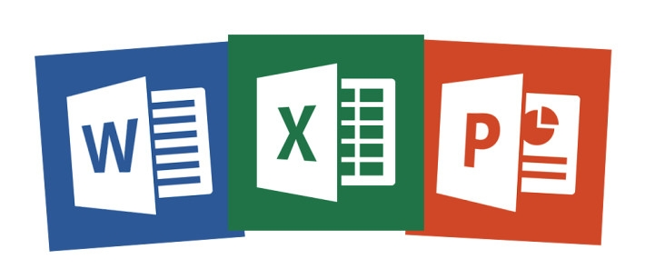
PowerPoint Joined Office Suite in 1989

Slide 6
Copies Sold

Slide 7
More Than Just Business
Artist, David Byrne has been using PowerPoint for years as part of his work.

Slide 8
Time for You to be Creative

Slide 9
Thank You
John Larson, UNLV

Slide 10
Working With Objects

Slide 11
Working with Text
This is WordArt

Slide 12
Text Direction
Stacked
Horizontal
Rotate 270
Rotate 90

Slide 13
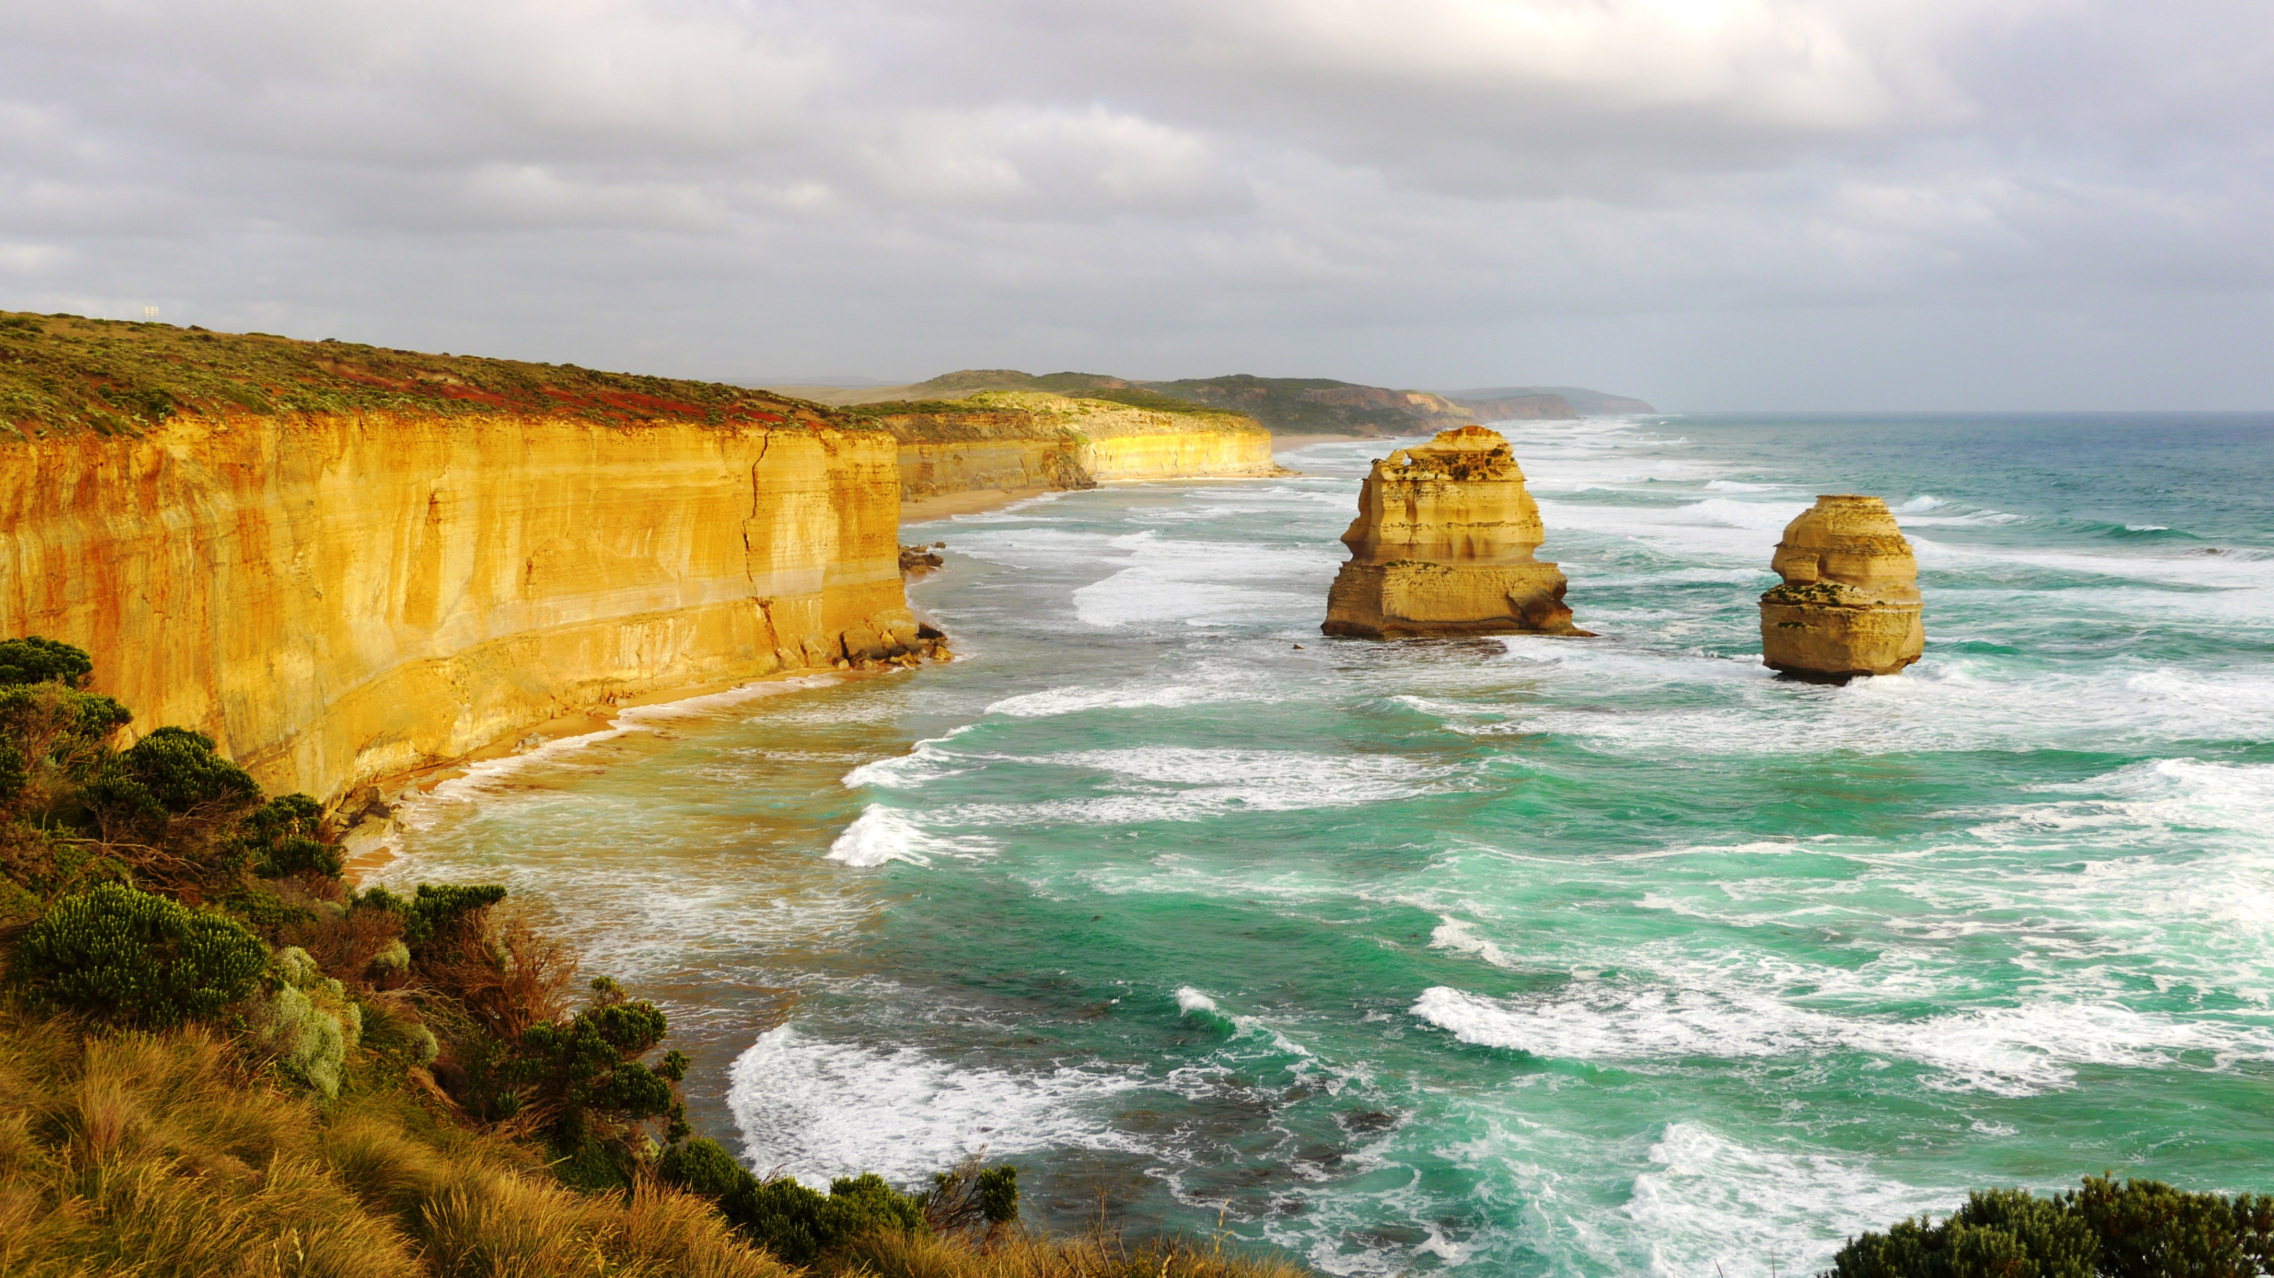
IMages

Slide 14
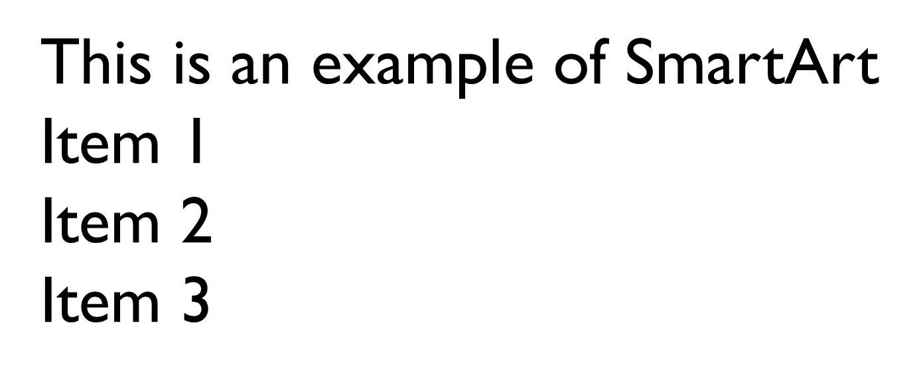
SmartArt

Slide 15
Background Picture

Slide 17
Icons

Slide 18
Tables

Slide 19
Transitions
Hi There!

Slide 20
Using Video

Slide 21
Using Audio

Slide 22
Screen Recording
This is a sample of screen recording.

